Slide 1
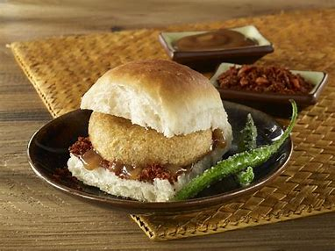

Case Study – Vada Pav Shop (A study for the new Vada Pav shop in the Shivaji Nagar , Pune)

Slide 2
Introduction:
Problem: A man wants to open a Wada Pav Shop near Shivaji Nagar in Pune. He has got a location where there are other 4 more wada pav shops. He is not able to understand what will be the strategy to take over his clients.
What will be the price of each Wada Pav?
b. How will he differentiate from the other competitors?
c. How will you bring insights when he has no data of his shop?
d. Why will be the Customer comes to your shop? (What will be the positioning)
e. What Machine Learning Models you will used to take to solve this Problem Statement? Whether Data Science is really required or not?

Slide 3

A.Pricing
Price of Vada Pav in other shops
Affordable price

Slide 4
B. Differentiation
Customer Acquisition:
Seating Arrangement
Good Menu of Vada Pav
Provide Hygiene food
Cleanliness of shop
Some offers notification through customer mobile number
Attractive banner of shop
Social Media:
Advertisement in News Paper , Banner
Instagram
Facebook
Just dial
Food blogs WordPress

Slide 5
Delivery:
Zomato
Swiggy
Travelkhana
Freshmenu
JustEat
Foodpanda
Payment Mode:
Cash
BHIM
UPI
G-PAY
Phone Pay

Slide 6
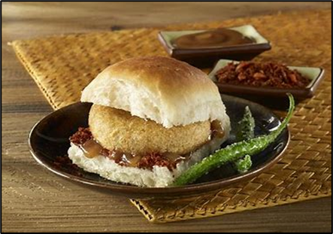
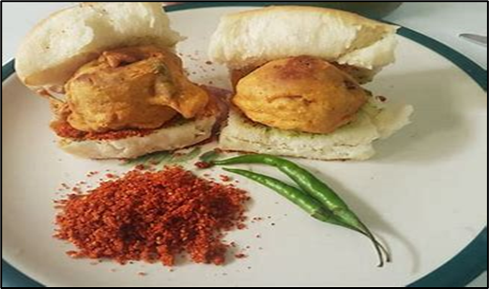
Top 5 Vada Pav shops near Shivaji Nagar in Pune

Slide 7
C . Competitor's Analysis SWOT Analysis
STRENGTHS
Unique taste
Quality ingredients
Friendly staff
Live Entertainment
Seasonal Menu
Good review
WEAKNESSES
Competitors with low prices
Modest advertising budget
Not well known in market
Single location means limited reach
No business website
Short business hours
Less contact of Vendors
OPPORTUNITIES
Growing interest in /support for locally sourced ingredients
Seasonal menu keeps things fresh and interesting
Potential for growth via food delivery apps/technology
Could partner with coffee shop next door
THREATS
Negative Reviews
High turnover
Technology changes
Competition
Rising costs of ingredients
Uncertain Economic Environment

Slide 8
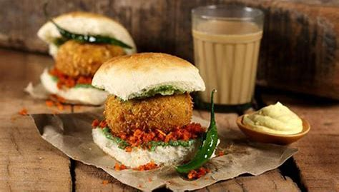
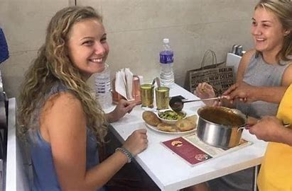
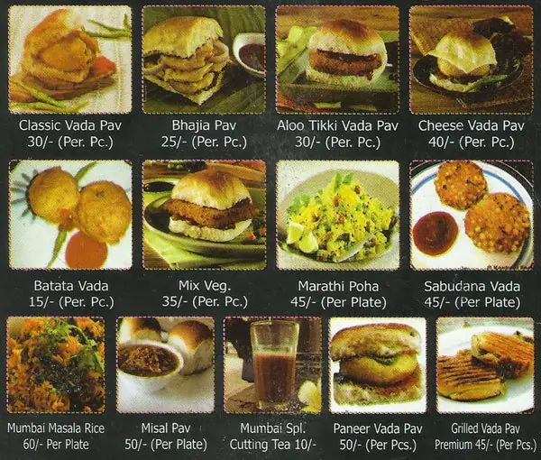
D . Positioning
A good quality product with different verity
Standard raw materials and fresh food for customers
Live Entertainment
Digital advertising and traditional advertising(Print , TV , radio)
Mainly students , couples , employees
Clean and Hygienic branded Vada pav
Low price with best quality compare to others
Best Services and Amenities compare to others

Slide 9
Thank You

